Slide 1
Updates on Projective Texture Mapping
Nov., 12, 2015
Kwan-Hee Yoo
Chungbuk National University, Korea

Slide 2





Contents
Ⅰ
Brief Discussion
Ⅱ
Proposed Nodes
Ⅲ
Example

Slide 3
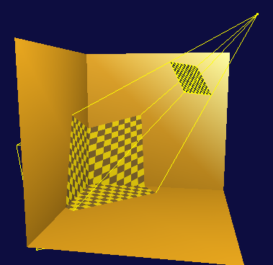
I. On Projective Texture Mapping
A method for texture mapping which allows the texture image to be projected onto the scene as if by a slide projector[Cass Everitt, 1999)
A projector
(location and orientation)
A texture image
A view volume:
(perspective or parallel)
Projected Texture image onto the scene
DEMO

Slide 4

I. History
The projective texture mapping was proposed as standardization item into X3D at SC24 WC6 Meeting, 2008
* Any nodes for projective texture mapping are not specified into X3D yet
For last four years, several sample examples for projective texture mapping have been developed.
Current, implementation results of projective texture mapping have transferred into X3D browsers such as freeWRL, Xj3D etc.

Slide 5
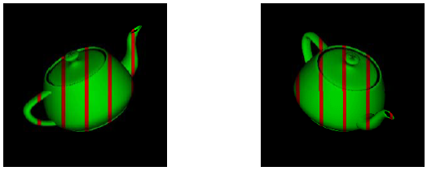
I. Projective Texture theory
Eye Linear
- Texture is “fixed” in eye space

Slide 6
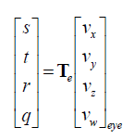
I. Projective Texture theory
Eye Linear
Eye Linear Texgen Transform
- multiply Eye space coordinate and Te(Texgen matrix)

Slide 7
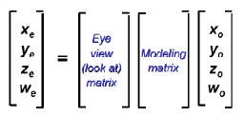
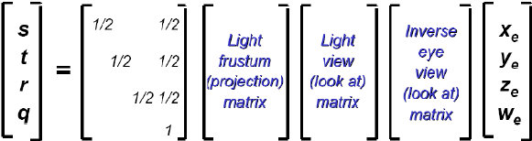
I. Projective Texture theory
Eye Linear Texgen Transform
glTexGen automatically applies this when modelview maxtirx
Contains just the eye view transform
Eye space coordinate
Te(TexGen matrix)

Slide 8
II. Proposed Nodes
X3DTextureProjectorNode
X3DTextureProjectorNode : X3DChildNode
TextureProjectorPerspective: X3DTextureProjectorNode
TextureProjectorParallel : X3DTextureProjectorNode

Slide 9
II. Proposed Nodes
X3DTextureProjectorNode
X3DTextureProjectorNode : X3DChildNode{
SFNode [in,out] metadata NULL [X3DMetadataObject]
SFString [in,out] description “”
SFVec3f [in,out] location 0 0 0 (-∞,∞)
SFVec3f [in,out] direction 0 0 1 (-∞,∞)
SFFloat [out] aspectRatio
SFFloat [in,out] nearDistance 1
SFFloat [in,out] farDistance 10
SFBool [in,out] global true
SFBool [in,out] on true
SFNode [in,out] texture NULL
[X3DTexture2DNode]
}

Slide 10
II. Proposed Nodes
TextureProjectorPerspective
TextureProjectorPerspective : X3DTextureProjectorNode {
SFNode [in,out] metadata NULL [X3DMetadataObject]
SFString [in,out] description “”
SFVec3f [in,out] location 0 0 1
SFvec3f [in,out] direction 0 0 1
SFFloat [in,out] fieldOfView π/4 (0,π)
SFFloat [out] aspectRatio
SFVec3f [in,out] upVector 0 0 1
SFFloat [in,out] nearDistance 1
SFFloat [in,out] farDistance 10
SFBool [in,out] global true
SFBool [in,out] on true
SFNode [in,out] texture NULL
[X3DTexture2DNode]
}

Slide 11
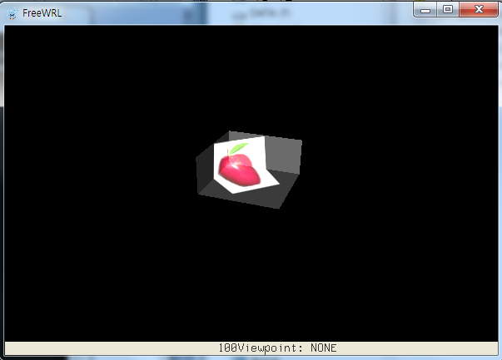
Example
TextureProjectorPerspective – Example(Apple)
<X3D profile="Interactive" version="3.3">
<Scene>
<TextureProjectorPerspective
description='pt1' location='3 3 3' direction='-1 0 -1'
fieldOfView='15' nearDistance='1' farDistance='10'
upVector='0 1 0' global= 'true' on= 'true'>
<ImageTexture url='C:/image/apple.jpg' repeatS='false' repeatT='false'/>
</TextureProjectorPerspective>
<Shape>
<Appearance>
<Material diffuseColor='0.5 0.5 0.5'/>
</Appearance>
<IndexedFaceSet solid='false' coordIndex="3 2 1 0 -1, 4 5 2 3-1, 5 6 1 2 -1">
<Coordinate point="1 0 1, -1 0 1, -1 0 -1, 1 0 -1, 1 1 -1, -1 1 -1, -1 1 1 "/>
</IndexedFaceSet>
</Shape>
</Scene>
</X3D>

Slide 12
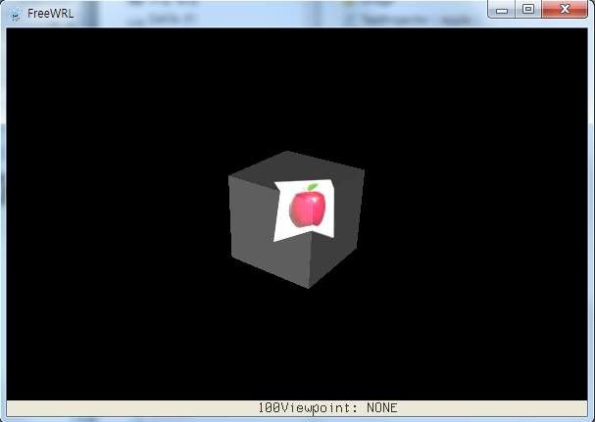
Example
TextureProjectorPerspective – Example(Box)
<X3D profile="Interactive" version="3.3">
<Scene>
<TextureProjectorPerspective
description='pt1' location='3 3 3' direction='-1 -1 -1'
fieldOfView='15' nearDistance='1' farDistance='10'
upVector='0 1 0' global= 'true' on= 'true'>
<ImageTexture url='C:/image/apple.jpg' repeatS='false' repeatT='false'/>
</TextureProjectorPerspective>
<Shape>
<Appearance>
<Material diffuseColor='0.5 0.5 0.5'/>
</Appearance>
<Box/>
</Shape>
</Scene>
</X3D>

Slide 13
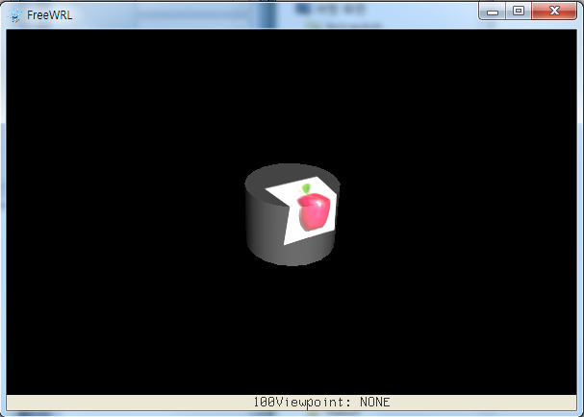
Example
TextureProjectorPerspective – Example(Cylinder)
<X3D profile="Interactive" version="3.3">
<Scene>
<TextureProjectorPerspective
description='pt1' location='3 3 3' direction='-1 -1 -1'
fieldOfView='15' nearDistance='1' farDistance='10'
upVector='0 1 0' global= 'true' on= 'true'>
<ImageTexture url='C:/image/apple.jpg' repeatS='false' repeatT='false'/>
</TextureProjectorPerspective>
<Shape>
<Appearance>
<Material diffuseColor='0.5 0.5 0.5'/>
</Appearance>
<Cylinder radius='1' height='1.5'/>
</Shape>
</Scene>
</X3D>

Slide 14
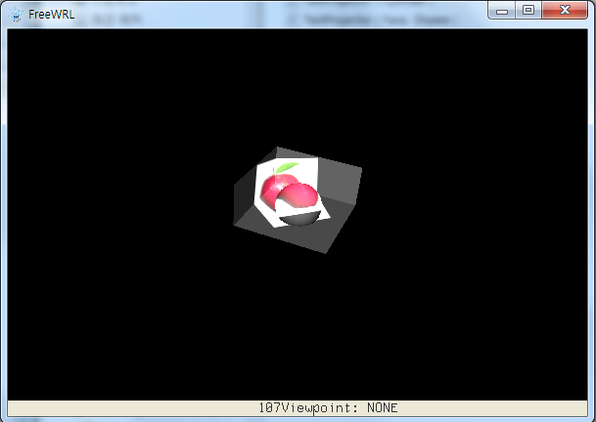
Example
TextureProjectorPerspective – Example(Face + Sphere)
<X3D profile="Interactive" version="3.3">
<Scene>
<TextureProjectorPerspective
description='pt1' location='3 3 3' direction='-1 0 -1'
fieldOfView='15' nearDistance='1' farDistance='10'
upVector='0 1 0' global= 'true' on= 'true'>
<ImageTexture url='C:/image/apple.jpg' repeatS='false' repeatT='false'/>
</TextureProjectorPerspective>
<Shape>
<Appearance>
<Material diffuseColor='0.5 0.5 0.5'/>
</Appearance>
<IndexedFaceSet solid='false' coordIndex="3 2 1 0 -1, 4 5 2 3-1, 5 6 1 2 -1">
<Coordinate point="1 0 1, -1 0 1, -1 0 -1, 1 0 -1, 1 1 -1, -1 1 -1, -1 1 1 "/>
</IndexedFaceSet>
</Shape>
<Transform translation='0,0.25,0'>
<Shape>
<Appearance>
<Material diffuseColor='0.5 0.5 0.5'/>
</Appearance>
<Sphere radius = '0.5'/>
</Shape>
</Transform>
</Scene>
</X3D>

Slide 15
II. Proposed Nodes
TextureProjectorParallel
TextureProjectorParallel : X3DTextureProjectorNode{
SFNode [in,out] metadata NULL [X3DMetadataObject]
SFString [in,out] description “”
SFVec3f [in,out] location 0 0 1
SFVec3f [in,out] direction 0 0 1
SFFloat [out] aspectRatio
MFFloat [in,out] fieldOfView -1, -1, 1 1 (-∞,∞)
SFFloat [in,out] nearDistance 1
SFFloat [in,out] farDistance 10
SFBool [in,out] global true
SFBool [in,out] on true
SFNode [in,out] texture NULL
[X3DTexture2DNode]
}

Slide 16
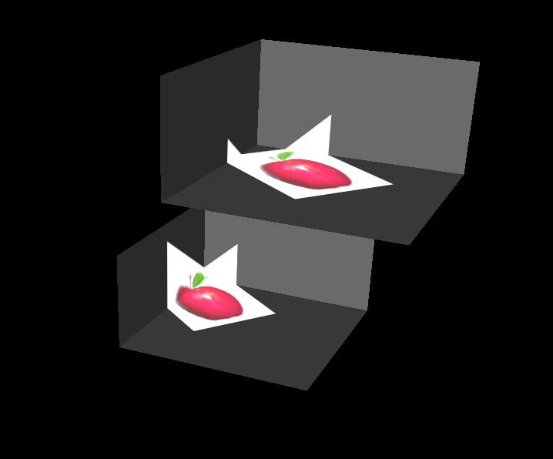
<X3D profile="Interactive" version="3.3">
<Scene>
<TextureProjectorParallel
description='pt1' location=‘3 5 3' direction='0 1 1'
fieldOfView='0 1 -0 1' nearDistance='1' farDistance='10'
global= 'true' on= 'true'>
<ImageTexture url='C:/image/apple.jpg' repeatS='false' repeatT='false'/>
</TextureProjectorParallel>
<Shape>
<Appearance>
<Material diffuseColor='0.5 0.5 0.5'/>
</Appearance>
<IndexedFaceSet solid='false' coordIndex="3 2 1 0 -1, 4 5 2 3-1, 5 6 1 2 -1">
<Coordinate point="1 0 1, -1 0 1, -1 0 -1, 1 0 -1, 1 1 -1, -1 1 -1, -1 1 1 "/>
</IndexedFaceSet>
</Shape>
<Shape>
<Appearance>
<Material diffuseColor='0.5 0.5 0.5'/>
</Appearance>
<IndexedFaceSet solid='false' coordIndex="3 2 1 0 -1, 4 5 2 3-1, 5 6 1 2 -1">
<Coordinate point="2 2 2, 0 2 2, -0 2 -0, 2 2 0, 2 3 0, 0 3 0, 0 3 2 "/>
</IndexedFaceSet>
</Shape>
</Scene>
</X3D>

Slide 17
Thank you
Q&A
khyoo@chungbuk.ac.kr

